Slide 1

INSURANCE FRAUD DETECTION
Group 3 Repository:
Auto_Insurance_Claims
Xinyi Hu
Nehal Jain
Gayatri Krishnamoorthy
Juliana Liu
Solomon Gomez
Aishwarya Rao
Nancy Samuel
Notes:
HI everyone,
We are here to present our extension of previous project for insurance fraud detection.

Slide 2

OUR TEAM
Nehal
Aishwarya
Nancy
Gayatri
Product Manager
/ Backend Developer
nehalj12
Business Analyst/ Backend Developer
aishwaryarao595
Data Analyst/ Scientist
nancieeyy
Data Analyst/ Scientist
Gayatrik9
Solomon
Juliana
Xinyi
Data Scientist/ UI Developer
solomongomez
Data Scientist
julianaliu1997
Data Scientist
Syrenia
Notes:
Aishwarya

Slide 3
CONTEXT
Competitive Landscape
Price hardening cycle
Industry revenue declined 5.0% in 2020
37.0% of consumers are likely to purchase auto insurance online in the future
Fraud detection becomes increasingly crucial for an online-focused strategy shift
Business Problem
Auto insurers lose at least $29 billion a year due to premium leakage, according to Verisk
Objectives and Benefits
Predict the likelihood of auto insurance fraud through a classification model
Performance Metrics
F1 Score
Precision
ROC-AUC
Source: IBISWorld, Insurance Information Institute
Notes:
Aishwarya - 1min
Competition has become fierce with online-focused discount insurer entering the market
According to the latest available information from comScore, 37.0% of consumers are likely to purchase auto insurance online in the future
Hence, fraud detection becomes increasingly crucial for an online-focused strategy shift
This leads to
People filing claims online by taking pictures of defective parts and making payments based on these fake pictures which leads to vulnerability to staged accidents which could cause Auto insurers to lose at least $29 billion a year
Given the cruciality of its nature, we decided to continue to pursue this project in this semester and make it as a web application that is production level ready.
Here, we focus on predicting how likely a claim is fraudulent through a classification model
We’ve used FI Score instead of focussing just on recall based on the feedback received in our last presentation as our primary metric because we are interested in detecting as many abnormal records as possible, considering the downside of not detecting one is a lot higher than otherwise

Slide 4
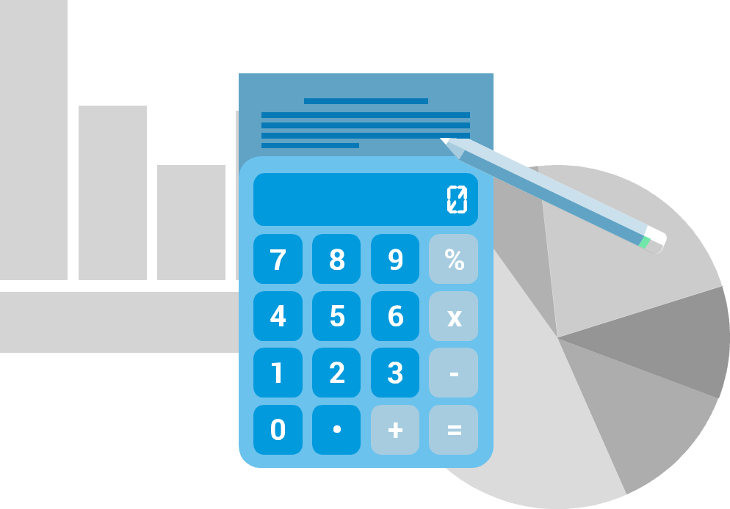




HYPOTHESES / PROBLEM STATEMENT
Logical: A classification tool will help the company’s decision making process
H0: The claim application is not fraudulent Witness present, Base policy, Deductible
H1: The claim application is fraudulent Accident Area, Age, Fault, Past Number of claims
 | Claim is not fraudulent | Claim is fraudulent
Predict as fraudulent | Type I Error (False Positives) | Correct Outcome
Predict as not Fraudulent | Correct Outcome | Type II Error (False Negatives)
Notes:
Nancy - 1min
Traditionally businesses relied on rules alone to block fraudulent claims. This causes problems: - lots of rules tends to result in a high number of false positives - meaning you’re likely to block a lot of genuine customers.
- Fixed outcomes are risky since the thresholds can change over time.so they aren’t robust.
And hence our logical assumption is that a classification tool will help in the company’s decision making process. since this is where Machine learning models shine when you don’t know the exact signals that indicate fraudulent activity, but model identify the signals itself.
So we assume our null hypothesis to be the status quo: under ideal circumstances.

Slide 5
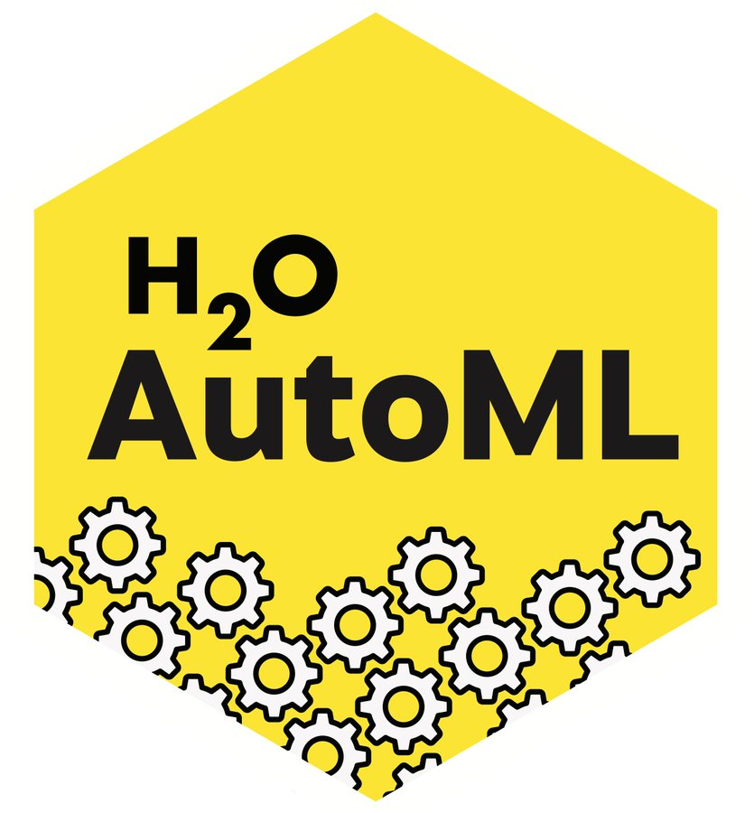

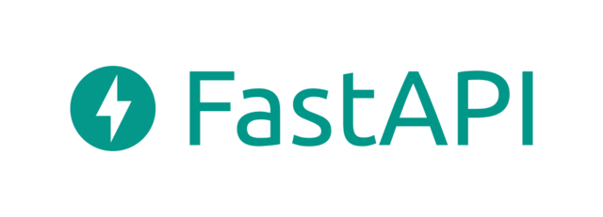


Solution Architecture
AutoML
Data Preprocessing + Feature Selection
Model Training and Model Evaluation
Model Serving
Training, Validation Data
REST API Request
UI
New Data
Notes:
Nehal - 2 min
I’d like to start by giving a brief overview of our solution to the problem mentioned.
The first part of the solution was to build a ML model that would help predict the claim being Fraudulent or Genuine. For this we have changed the model implementation from previous course to now have an AutoML. We tried to versions of AutoML namely - Databricks AutoML and H2O AI. Both of them include Data Preprocessing, Feature Importance, Model training and Evaluation for using different model configurations.
The next part of solution is to predict for new data. In order to to so, we created a wrapper service using FastAPI to get the model predictions. All this resides in a single docker container.
We have also developed a UI where the user can enter the new values and get a prediction whether their claim would be accepted or marked fraudulent. This was developed using React JS and separately containerized. It internally calls the FAST API service to get predictions.

Slide 6
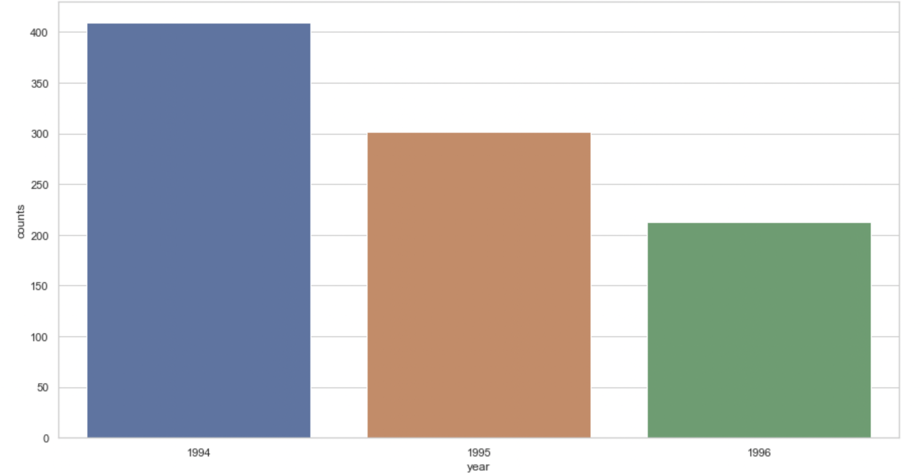
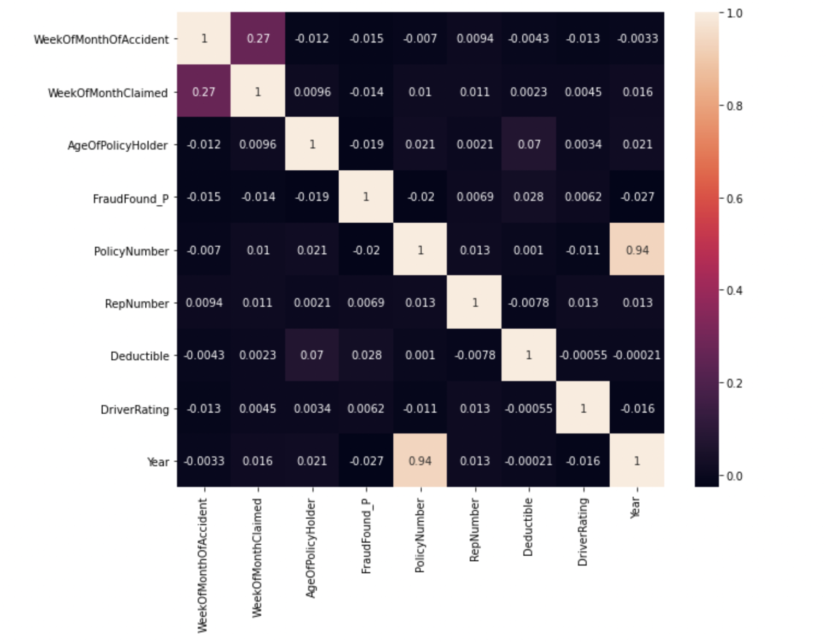
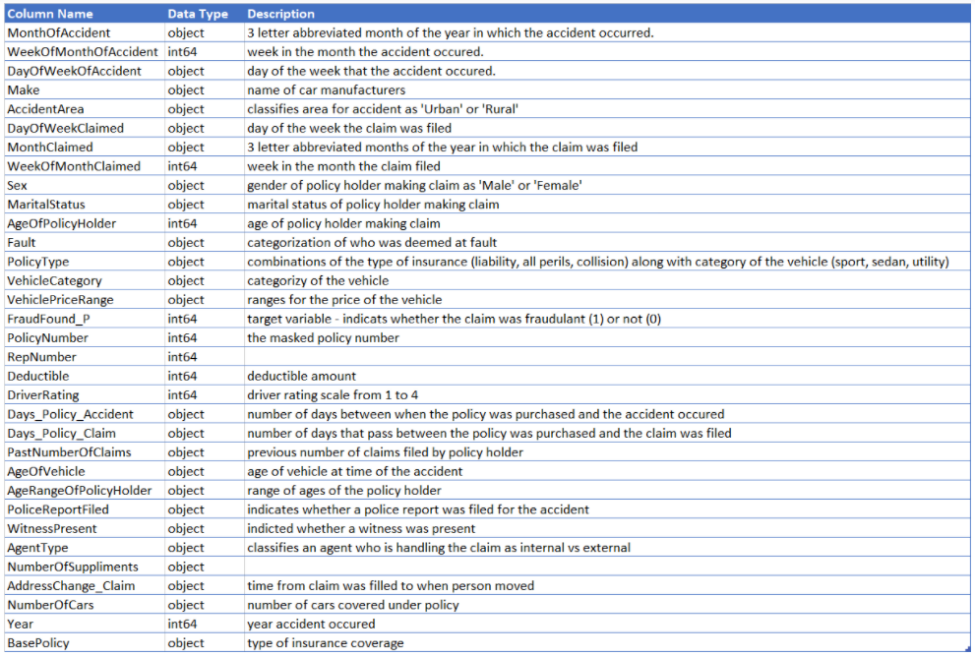
Data Acquisition and Statistics
Data Acquisition and Statistics
Data Exploration
Data Preprocessing and Transformation
Source : Kaggle-vehicle-claim-fraud-detection
Distribution
Trends
Patterns
Outliers
Correlation
Variable types | Number of variables
Categorical | 22
Numeric | 9
Boolean | 2
Handling missing values - replacing by mean value
Feature encoding - one hot encoding
Feature standardization
Prevention of overfitting and handling imbalance data
Number of fraudulent claims across years
Notes:
Data acquisition - This vehicle dataset has been taken from Kaggle. This dataset contains vehicle attributes - , model, accident details, policy details - policy type, tenure etc. The target is to detect if a claim application is fraudulent or not - FraudFound_P
Data exploration - We see how various features are related to each other, their effect on target variables. Distribution, Patterns,trends,outliers, effect of missing values, proportion, correlation
Resampling -
Results are effective when we combine over sampling + under sampling

Slide 7


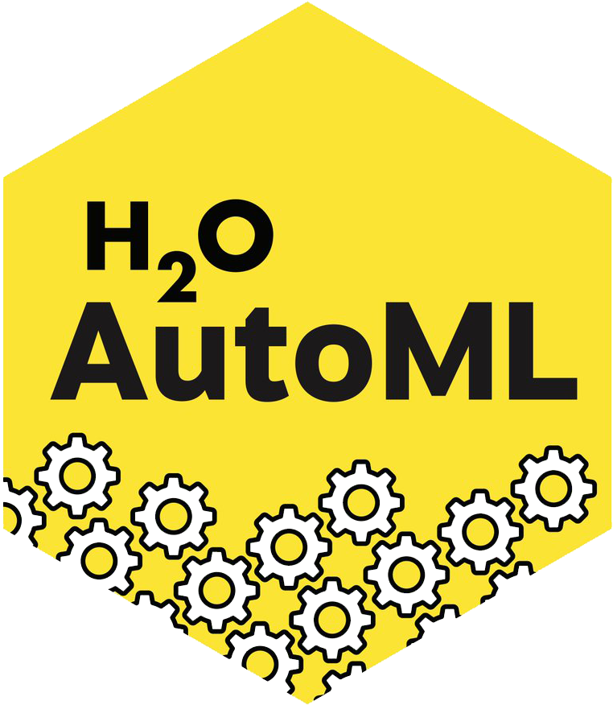
AutoML - Databricks
H₂O AutoML
H₂O architecture
Connect Databricks through Azure
REST API clients for Python, R, Excel
Advantages: - Automate the data preprocessing, feature engineering, modeling training and hyperparameter tuning. - Automatically generated editable notebooks for further customization - Using MLflow model serving to host the registered model as REST endpoints.
Install, Import and Initialize H₂O
Process
Language layer
Launch AutoML experiment & import the dataset
Algorithm layer
Convert dataframe to H₂O frame
Infrastructure layer
Set F1 score as the performance metrics
Hyper parameter optimization: - Max_runtime_secs
- Stopping_metric - Sort_metric - Balance classes Max_models
Pass to H₂O autoML function (auto preprocessing)
Configure, train and evaluate
Train the model
Advantages: - Ease of Implementation - Better performance - Explainability Disadvantages: - Limitations on a windows computer
Register model to the model registry
Leaderboard to view ranks of models by metrics
Steps:
1. Import the dataset
2. Launch the AutoML experiment, set F1 score as the metrics
3. AutoML configure -> training -> evaluate
• XGboost has the highest validation F1 score and test accuracy
4. Registering the model to the model registry
• Name: FauldDetection_Best_XGBoost
5. Deploy the model using MLflow model deployment
• Transit the model into production
Deploy using MLflow model deployment
- Save the model in binary/mojo format
- Use the saved model for predictions
Notes:
Juliana and Nancy - 3 min
1. What is AutoML? • Automated Machine Learning For our modeling, we used the automl because it is an automated end to end machine learning process that take care of things like data preparation, data preprocessing, feature selection, and selecting best model based on the selected performance metrics. There are different AutoML frameworks available, and we decided to implement 2 of them:
AutoML by Databricks: Why databricks and advantages:
Automate the data preprocessing, feature engineering, modeling training and hyperparameter tuning.
Automatically generated editable notebooks for further customization
Using MLflow model serving, it allows us to host our registered model from Model Registry as REST endpoints that are updated automatically based on the model versions.
Steps involved:import the dataset -> launch the autoML experiment and set F score as the metrics -> databricks will automatically configure, training and evaluate. We choose XGBoost based on the highest validation F1 score and accuracy -> register the model to the model registry -> finally deploy the model using ML flow model deployment
AutoML by H2o.ai: We also tried H2o open source AutoML.
Steps involved:
Install, import and initialize it: It can automatically check if there is an H2o instance running when we initialize it and starts the H2o cluster automatically.
An H2O cluster consists of one or more nodes. Each node is a process split into three layers: language, algorithms, and core infrastructure.
The first layer in the bottom section is the language layer. The language layer consists of an expression evaluation engine for R and the Scala layer.
The second layer is the algorithm layer. This layer contains an algorithms that are already provided in the H2O such as: XGBoost, GBM, Random Forest, K-Means etc.
The third layer is the core infrastructure layer that deals with resource management such as Memory and CPU management.
Convert the dataframe into an H20 frame, and pass it on to the H2o auto ml function which performs automatic preprocessing of Imputation, one-hot encoding and standardization, and then train the model.
By the leaderboard method, we can see all the models that performed the best according to various metrics and get the best model automatically.
We then saved the model. There are two ways to save the leader model -- binary format and MOJO format, we used the MOJO format since it's optimized for production use and used it for our predictions.
Why and Advantages:
It has a very simple interface for implementation - Reduce the need for expertise in machine learning by reducing the manual code-writing time.
It’s hyper parameter optimisation was very easy to implement. We used the hyperparameters of Max_runtime_secs: specifies the maximum time that the AutoML process will run for Stopping_metric: Specify the metric to use for early stopping. It defaults to logloss for classification, in our case. Sort_metric: Specifies the metric used to sort the Leaderboard by at the end of an AutoML run, is AUC for binary classification Balance_classes: Specify whether to oversample the minority classes to balance the class distribution Max_models:Specify the maximum number of models to build in an AutoML run, excluding the Stacked Ensemble models One learning that we had with H2o was that since data preprocessing is handled by AutoML automatically, if it sees an input in the test set which it has not found in the training set in terms of categorical variables, there are chances of it causing problems. So we saw that playing between the max runtime seconds or max models gave us some amount of control over there.
It had a better performance by having an accuracy of about 95% and the algorithm selected was a stacked ensemble.
There is also an explainability module (h2o.explain() which is a global method and h20.explain_row() for local implementations) by which the models can be automatically explained. It generated visualizations like a Variable Importance plot.
Issues faced: One problem that we experienced with H2o automl is that when it runs on a windows computer, it does not include XGBoost as one of the algorithms, and that we felt was a a limitations. This limitation did not exists when we ran it on google colab, but this was one of the learnings that we had.
Tasks covered under Auto ML: • Data Preparation: data cleaning, transformation, and normalization • Feature Engineering: engineering new features from the existing ones when it makes sense, selecting features to include into the model. • Algorithm Selection: selecting the model that works best available data. • Hyperparameter Optimization: tuning the most important hyperparameters for each model. • Model deployment: putting the best-performing model into action

Slide 8
Auto ML MODEL Performances
 | Performance Metrics
Models | Precision | Recall | F1 Score | AUC-ROC | Accuracy
Random Forest | 88.3% | 94.0% | 91.0% | 0.81 | 94.0%
XGBoost | 88.4% | 94.0% | 91.1% | 0.77 | 94.0%
Logistic Regression | 89.1% | 93.8% | 91.0% | 0.78 | 93.8%
Lightgbm | 88.3% | 94.0% | 91.0% | 0.76 | 94.0%
Decision Tree | 88.3% | 94.0% | 90.5% | 0.73 | 94.0%
We choose XGBoost because of Validation F1 Score
Notes:
Juliana - 30 sec
AutoML checked 5 models in total, compared with the model that we build last term, the XGBoost model generated by AutoML have higher accuracy in terms of F1 score and accuracy, therefore we chose XGBoost as our final model.

Slide 9
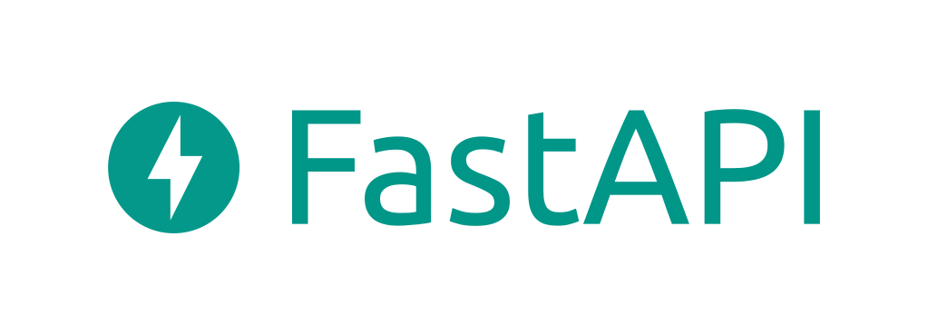

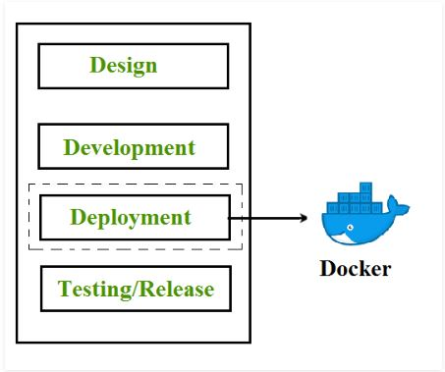
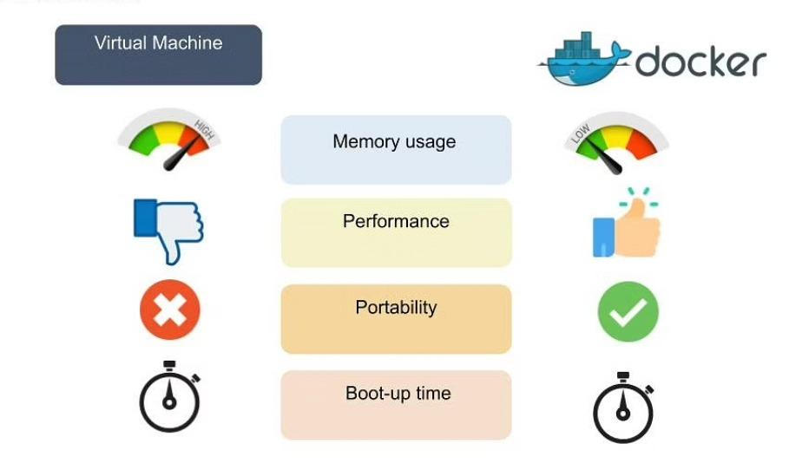
Key Benefits
Enable connection between Front end web-app and containerized model implementation.
Running applications in containers has a lot of advantages -
Portability
Performance
Agility
Isolation
Scalability
Compared to other RESTful APIs like Flask, Django
One of the fastest frameworks
Fast and easy to code
Fewer bugs
Short codes
Flexible
Notes:
Xinyi, Gayatri - 2 min
Here are the two main techniques we used in our deployment solution.
As for FastAPI, it enables …
User interacts with our web-app and inputs new data, fastapi sends request to our model and return the result from it, presenting to our user
Compared to … , fastapi has the following advantages
FastAPI: Fast API is flexible to code and doesn't restrict users to a particular project or code layout. Easy to learn especially for people who are new to web development.
Docker : easy create, deploy, and run applications in Docker containers, which have all the dependencies within them. The container itself is really just a very lightweight package that has all the instructions and dependencies—such as frameworks, libraries, and bins—within it.
Docker really shines in deployment, for rapid deployment and improved scalability. because when you deploy your solution, you want to be able to guarantee that the code that has been tested will actually work in the production environment. In addition to that, when you’re building and testing the code, having a container running the solution at those stages is also beneficial because you can validate your work in the same environment used for production.

Slide 10




Front-End Demo
Front-End Library
React Framework
React Components
Notes:
Sol - 2 min

Slide 11
CONCLUSION
Business Insights
Claims with Policy Holder’s Fault, Collision Base Policy, Higher Vehicle Price Range, more past claims are more likely to be fraudulent.
Threats to Validity / Limitations
User Experience - Rejection needs to be explained to customers
Limited Data from past years, single data source, not enough demographic information
Current architecture is designed for batch data, can’t accommodate stream data
Next Steps
Real time data flow
Cloud Deployment with Kubernetes clusters
Jenkins Pipeline
Notes:
Xinyi - 1 min
From our previous analysis in the last section, we have already gained some business insights regarding the Important factors to judge How likely is the claim Fraudulent. Our new deployment provides our potential users an interface to get the prediction results. And our docker solution enables users to access the prediction whether their local configuration is.
Threats to Validity:
For now, we only return a result that according to the input data, whether the insurance claim is a fraudulent claim or not. If we want to improve the user experience, we should interpret our model and provide explanation to users.
Another limitation of our current analysis is our data source. We used a single dataset from past years, so our current architecture is designed for batch data. For our next steps, we plan to integrate more data source like demographic information to increase the metrics of our model. We also plan to enable our solution to accommodate stream data, then we can train and iterate our model with real time data flow.
Next Steps:
Besides, we would like to upgrade our deployment to a cloud one with Kubernete clusters, in order to manage our containerized applications anywhere
Finally, we plan to build CI/CD Jenkins Pipeline for our solution to realize the automation of the updates in codes to container. CI/CD (continuous integration and deployment)

Slide 12

THANK YOU!

